Slide 1


Analyzing TikTok Data AUTHOR: AYVAZOGLU, TESSA NEJLA CHEN, KUN; Okafor, Chukwuemeka Date: July 29, 2024

Slide 2
CONTENT
INTRODUCTION
OBJECTIVES AND SCOPE
DATA VISUALIZATION
SWOT ANALYSIS
MODEL COMPARISON
CONCOLUTION

Slide 3

INTRODUCTION

Slide 4
Objectives
This project aims to enhance user engagement on TikTok through the application of artificial intelligence, improving content recommendations, and creating a more personalized user experience.
Scope
TikTok is a rapidly growing social media platform known for short-form video content. It has gained popularity for its unique algorithm-driven feed and diverse user base.
Analyzing TikTok data provides valuable insights into user behavior, content trends, and effective marketing strategies, crucial for businesses aiming to maximize engagement and reach on the platform.

Slide 5

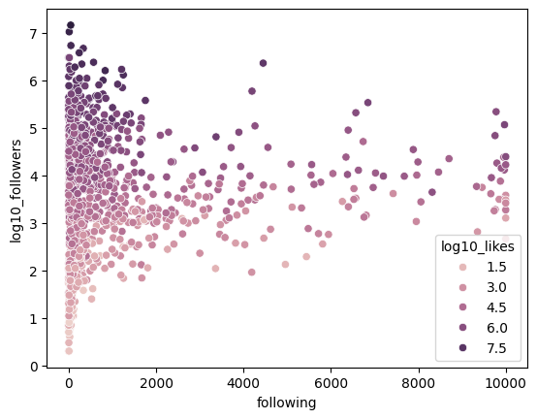
DATA VISUALIZATION
Followers and likes are essentially linearly related and following is independent

Slide 6
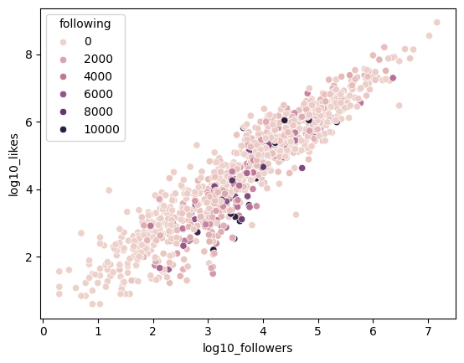
DATA VISUALIZATION
followers and likes are essentially linearly related and following is independent
增强演示效果

Slide 7
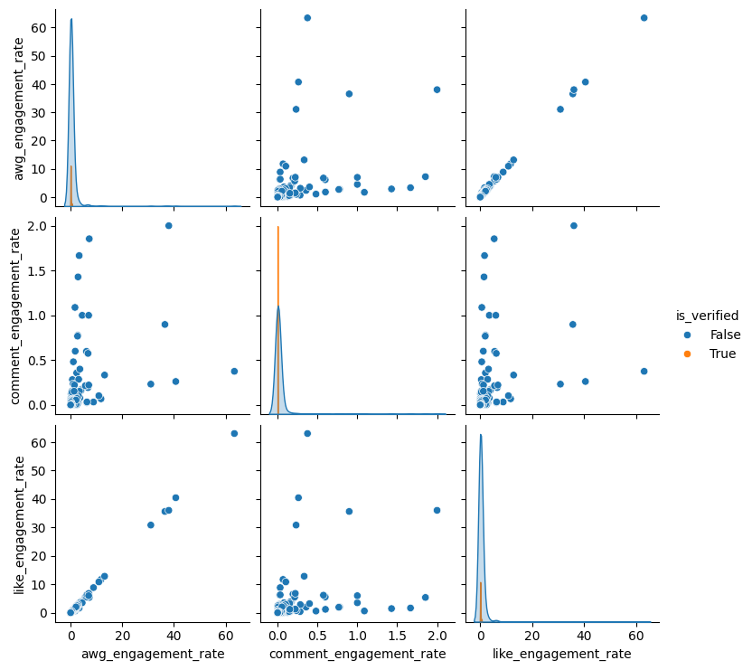
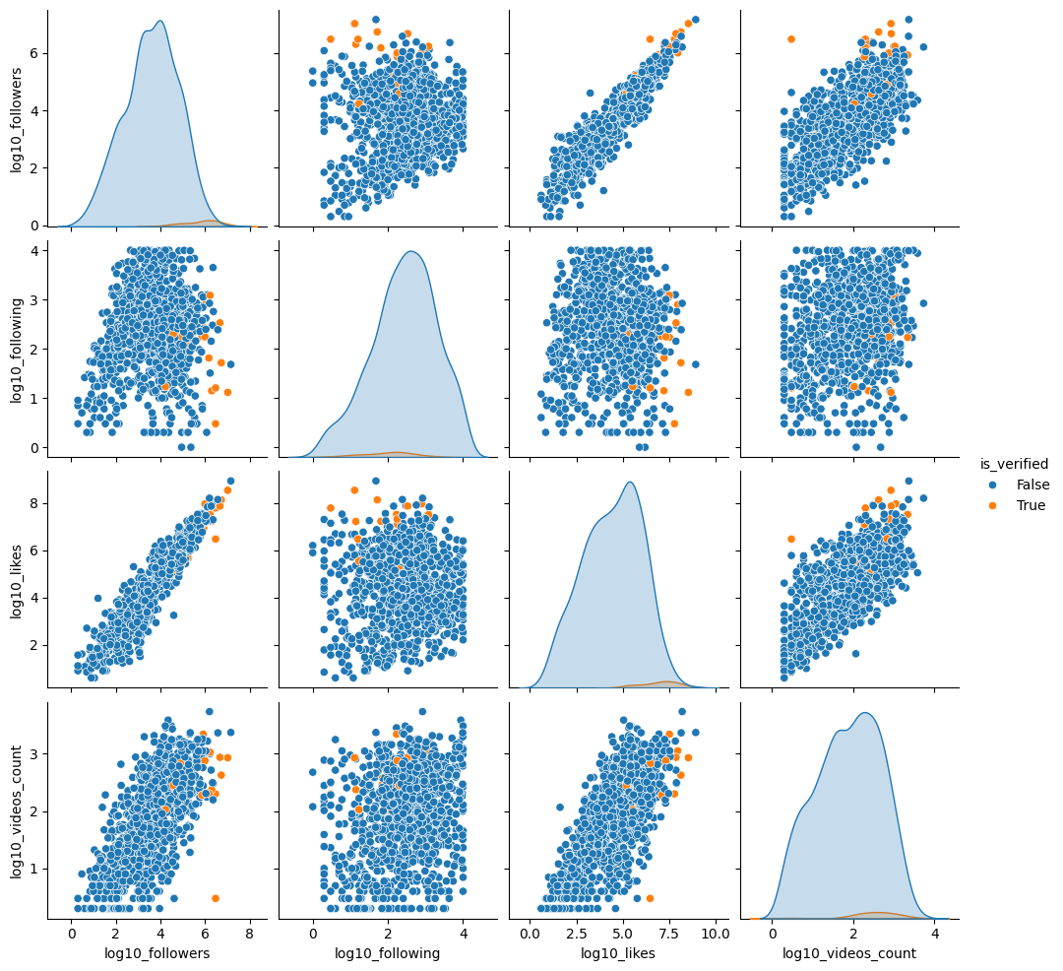
DATA VISUALIZATION
Notes:
Verified accounts are more likely to have lots of followers as well as higher enagements

Slide 8
SWOT ANALYSIS
Strengths:
High predictive accuracy: XGBoost has shown superior performance in our model (R-
squared of 0.83).
Efficient handling of large datasets: Suitable for TikTok's massive user base and data
volume.
Feature importance insights: Provides a clear understanding of factors influencing
engagement.
Flexibility: Can handle various types of input data and predict different engagement
metrics.
Weaknesses:
Complexity: XGBoost models can be more difficult to interpret than simpler algorithms.
Overfitting risk: Without proper tuning, there's a risk of overfitting to training data.
Computational resources: May require significant computational power for large-scale
deployment.
Data quality dependence: Performance heavily relies on the quality and relevance of input
data.

Slide 9
DATA PREPROCESS

Slide 10

MODLEING

Slide 11
MODLEING
Metric | Random Forest | XGBoost
Mean Squared Error (MSE) | 1.046 | 0.2835
R-squared Score | 0.7435 | 0.8296
Top Feature | Likes to Followers Ratio(24.49%) | Engagement Rate per Video (49.52%)
Second Feature | Followers (24.83%) | Likes to Followers Ratio(26.63%)
Third Feature | Videos Count (6.51%) | Following (21.95%)
Fourth Feature | Likes (5.47%) | Videos Count (0.84%)
Fifth Feature | Videos Followers Ratio (5.28%) | Likes (0.67%)
Overall Feature Importance | Less effective in capturing complex relationships | Better at capturing complex relationships

Slide 12
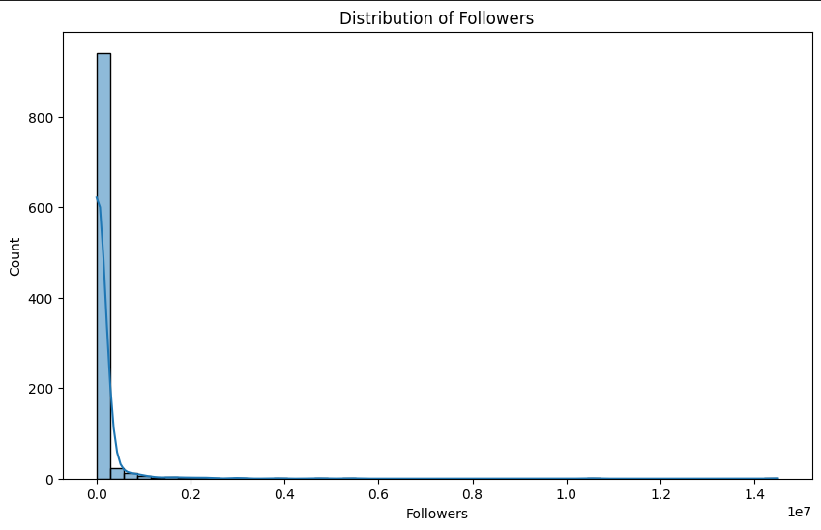
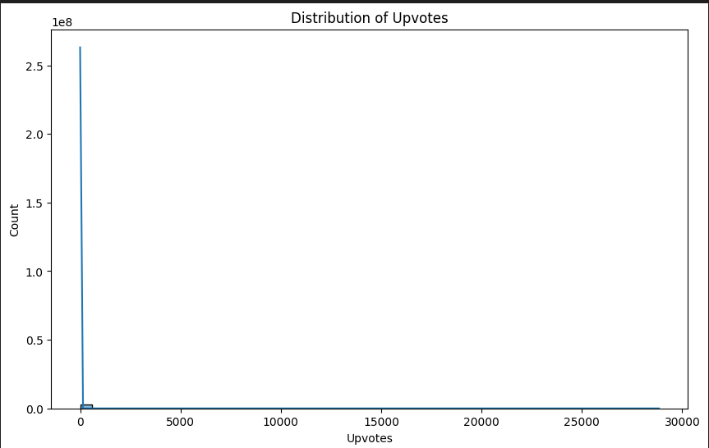
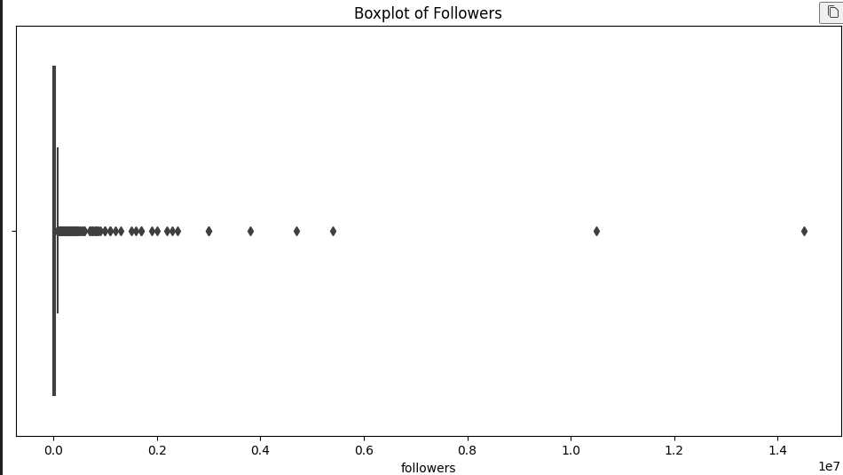
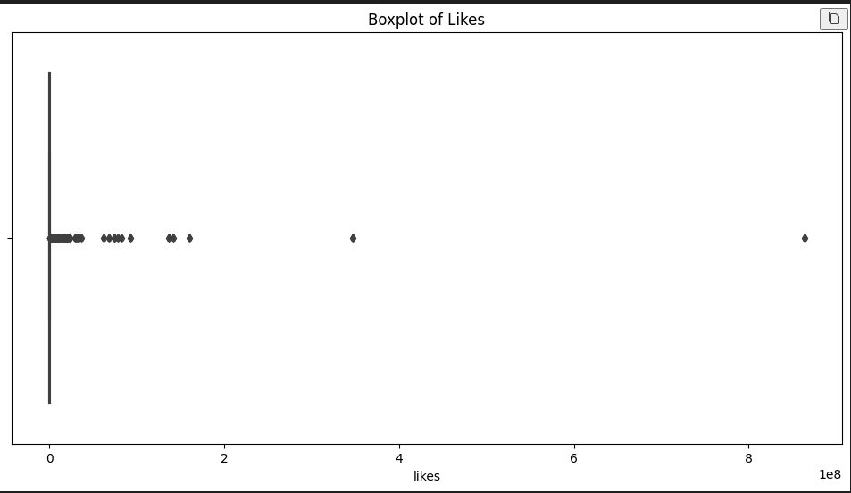
Strategic Implications (T)

Slide 13
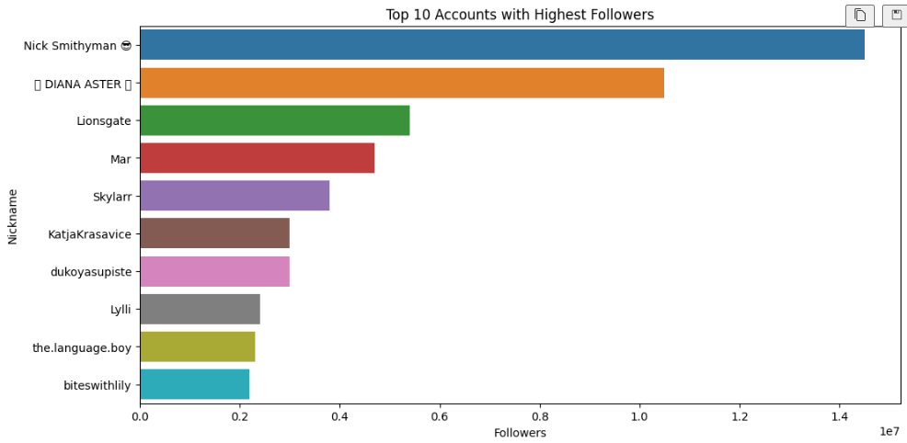
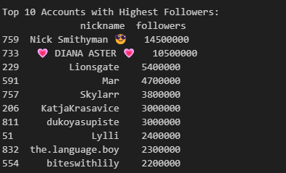
Strategic Implications (T)

Slide 14
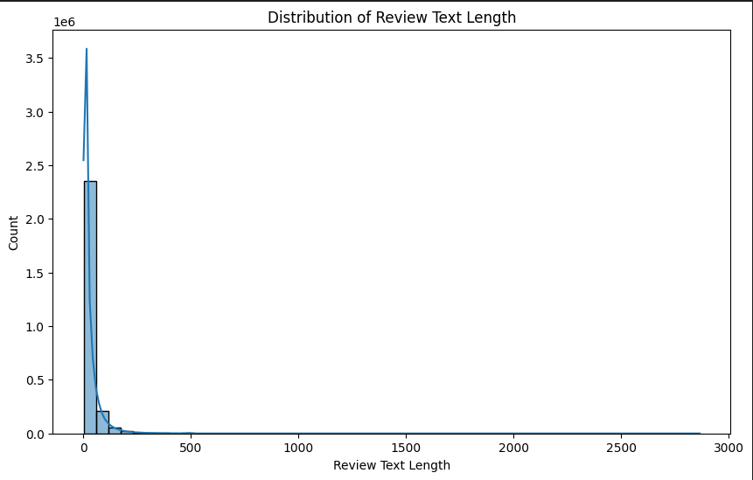
Strategic Implications (T)

Slide 15
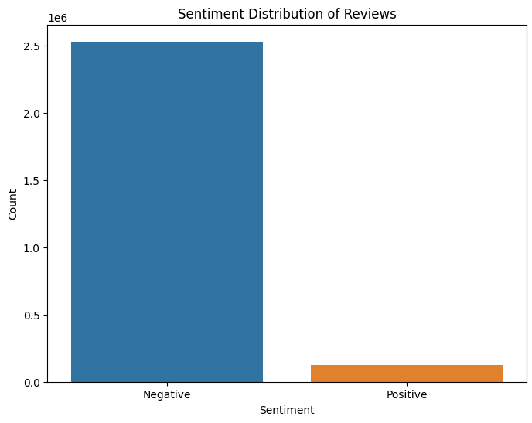
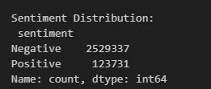
Strategic Implications (T)

Slide 16
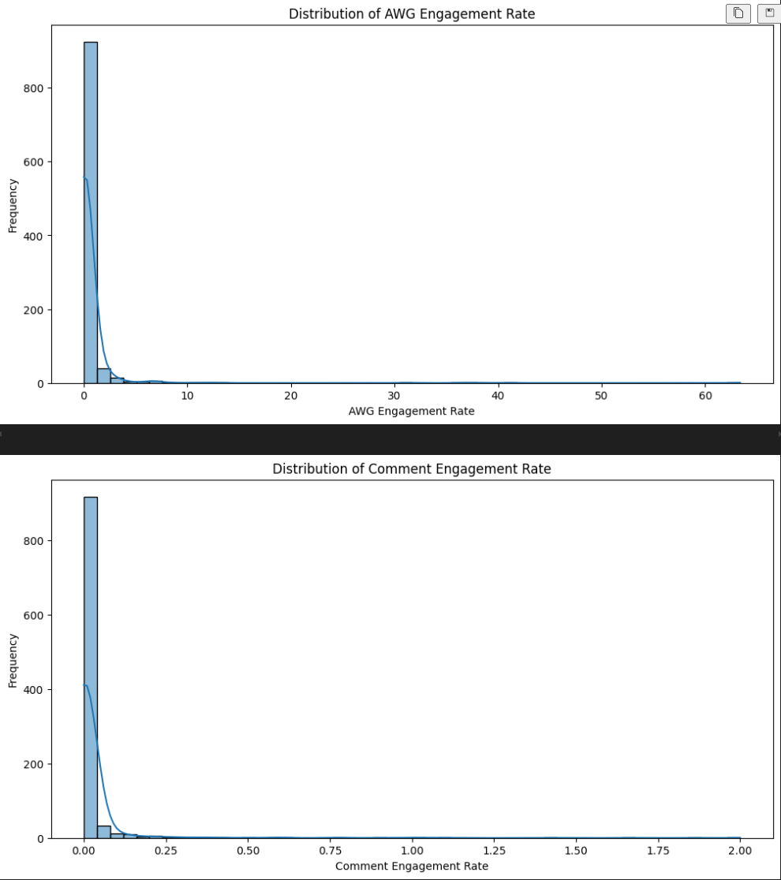
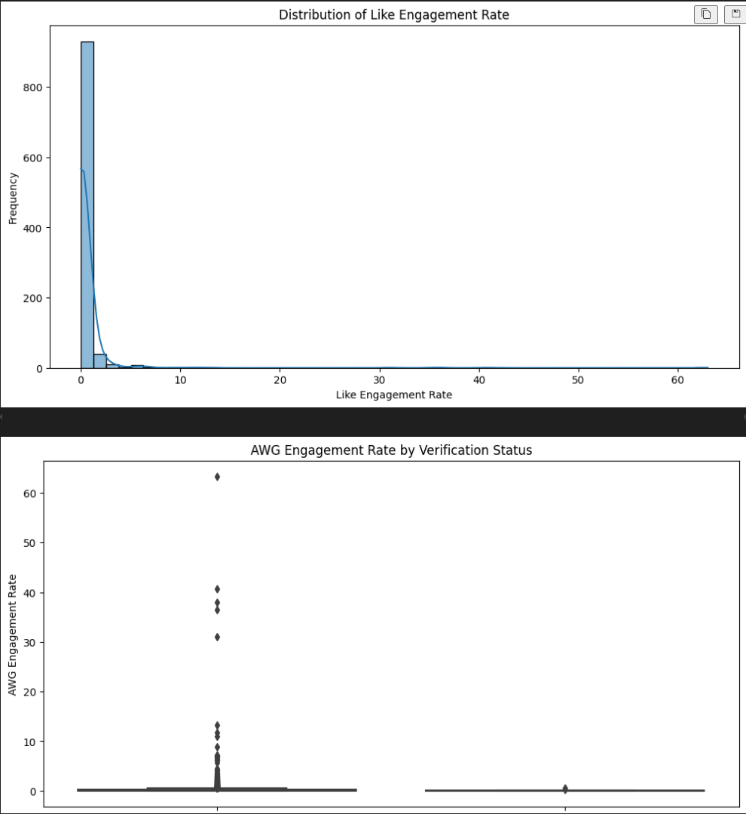
Strategic Implications (T)

Slide 17
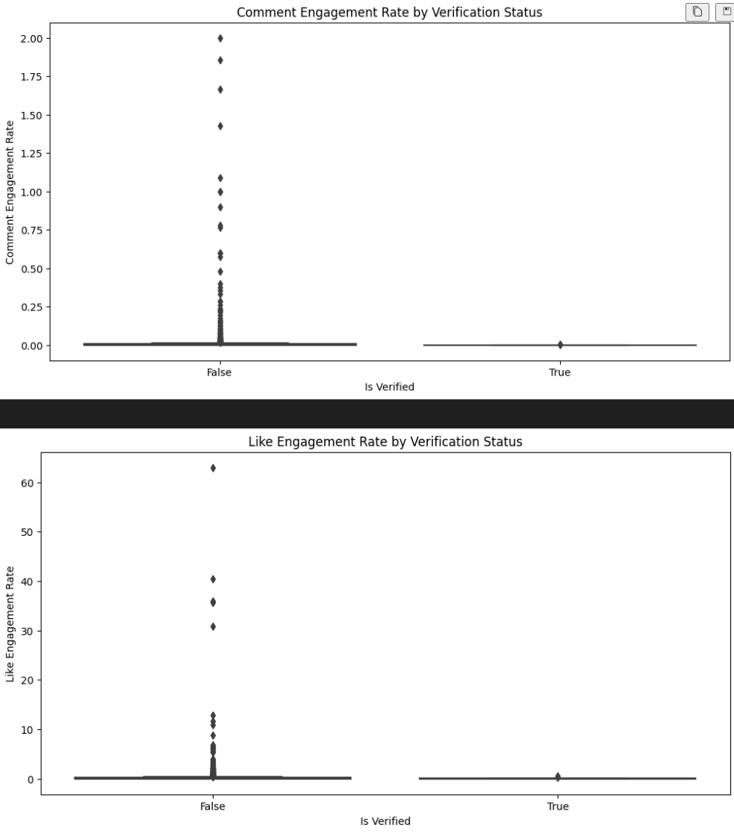
Strategic Implications (T)

Slide 18
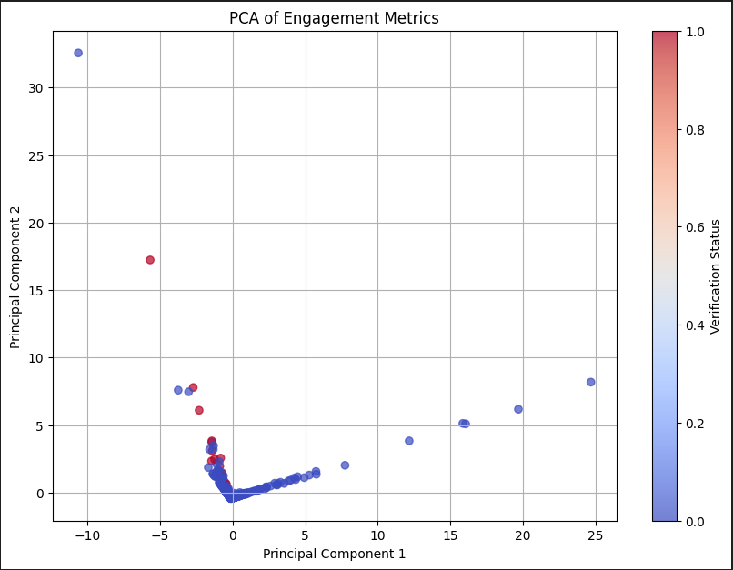
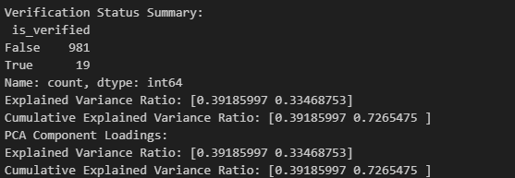
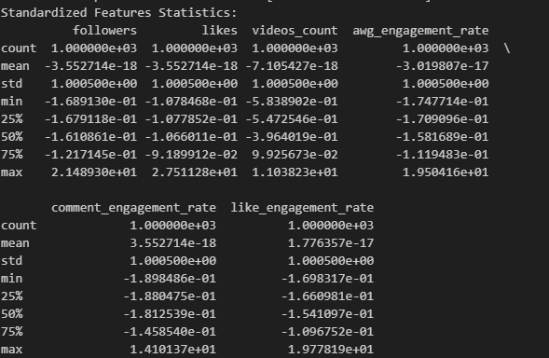
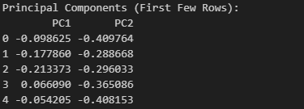
Strategic Implications (T)

Slide 19

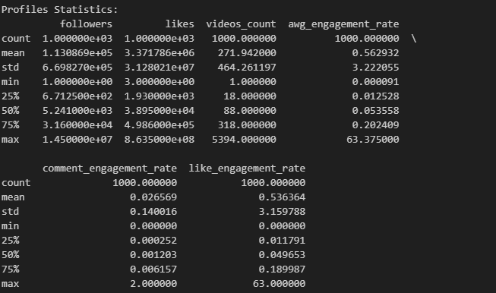
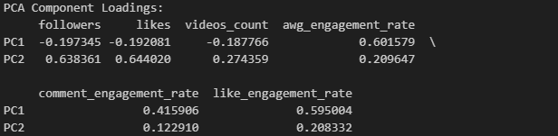

Strategic Implications (T)

Slide 20
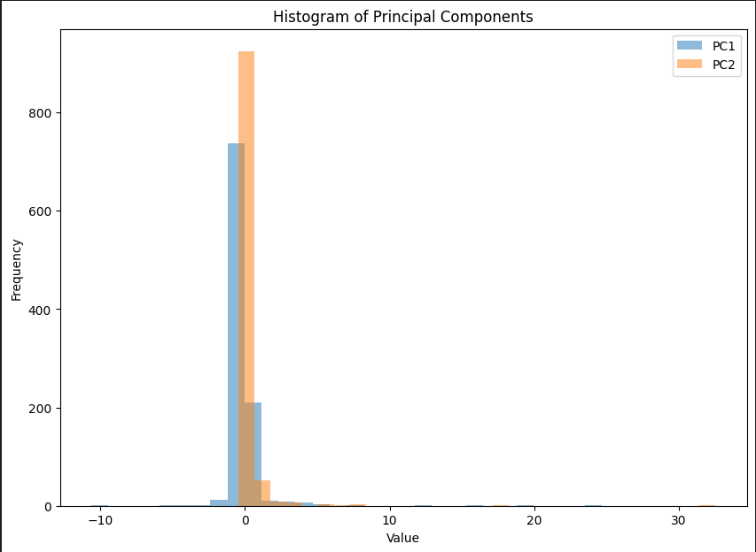

Slide 21
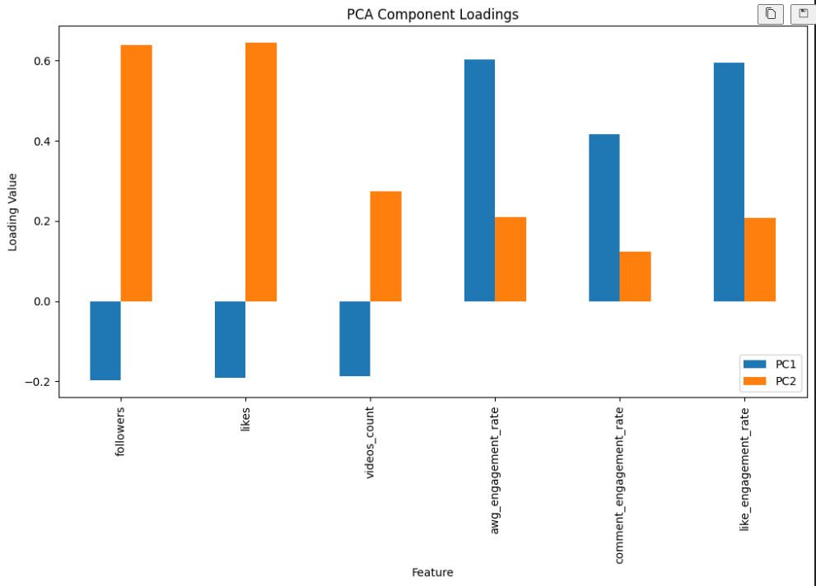

Slide 22
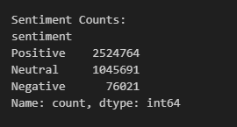
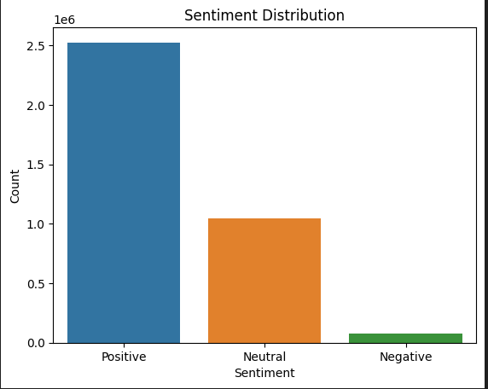

Slide 23
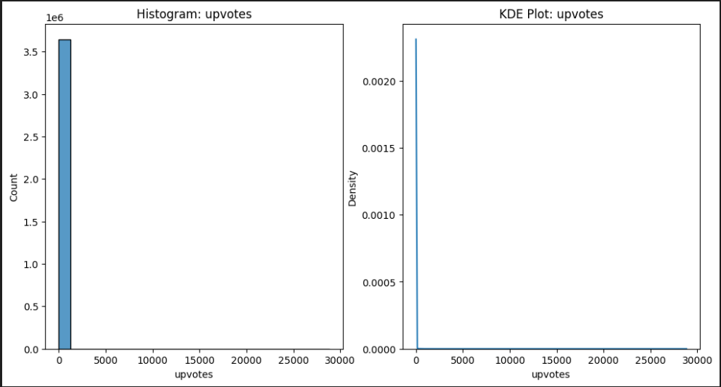

Slide 24
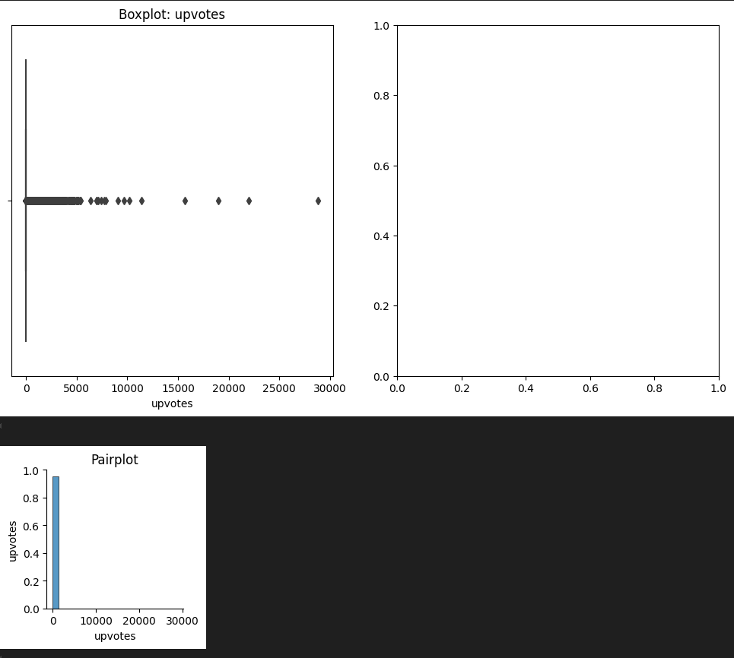

Slide 25
Strategic Implications (T)
Enhancing User Engagement & Sentiment Analysis:
Utilizing AI-Driven Recommendations to Personalize User Experiences and Increase Retention Rates:
Personalized Content Recommendations: Leverage TikTok's powerful algorithms to provide users with personalized content recommendations based on their interests and viewing habits. This encourages users to spend more time on the platform.
Events and Challenges: Regularly organize events and challenges that encourage user participation. This increases active engagement and strengthens the sense of community.
Feedback and Improvement: Regularly collect and analyze user feedback through sentiment analysis. Implement continuous improvements on the platform based on this feedback.
Reward Systems: Develop systems that reward users for their active participation. This increases user loyalty to the platform and encourages repeat usage.

Slide 26
Sentiment Analysis of TikTok App Reviews:
Dataset Overview:
Column Names: review_id, review_text, upvotes, app_version, posted_date
Sample Data: Display the first 5 rows of the dataset
Analysis Process:
Sentiment Analysis Function: Sentiment classification using TextBlob
Handling Missing Values: Replace missing values with empty strings
Adding Sentiment Column: Add sentiment classifications to the dataset
Sentiment Distribution:
Positive: 2,524,764
Neutral: 1,045,691
Negative: 76,021
Recommendations:
Leverage Positive Feedback: Utilize positive reviews to enhance appreciated features.
Address Negative Feedback: Focus on issues raised in negative reviews to improve the app.
Data Quality Assurance: Ensure data is properly cleaned and formatted for accuracy.
Next Steps:
Detailed Analysis: Explore specific themes and trends in the reviews.
User Segmentation: Segment feedback by demographics or app versions for targeted insights.
Continuous Monitoring: Implement ongoing sentiment analysis to track changes over time.

Slide 27
Conclusion:
The comprehensive analysis of TikTok profiles and reviews datasets has provided valuable insights into user engagement, content performance, and app feedback.
Here's a summary of the key findings and recommendations:

Slide 28
Key Insights:
High Engagement Discrepancy:
There is a significant disparity in engagement rates across profiles. High engagement rates could be attributed to various factors, including content quality and user niche.
Follower Count Skew:
A small number of accounts have exceptionally high follower counts, while the majority have fewer followers. This indicates a power-law distribution in follower counts.
Sentiment Analysis:
The majority of reviews are negative, highlighting potential issues with user satisfaction and areas needing improvement.
Data Gaps:
There are considerable missing values in the app version data of the reviews dataset, which may impact analyses related to app performance across different versions.
Verification Rarity:
Verified accounts are relatively rare, suggesting that verification is not common among TikTok users.

Slide 29
Recommendations:
Enhance User Engagement:
Focus on profiles with high engagement rates to understand what content resonates best with users.
Collaborate with top influencers to increase reach and engagement.
Improve App Features:
Address common issues identified in negative reviews to enhance user satisfaction.
Add features highlighted in positive feedback to improve the user experience.
Optimize Content Strategy:
Analyze top-performing videos to identify successful content trends.
Personalize content recommendations based on user preferences and behaviors.
Focus on Verified Accounts:
Collaborate with verified accounts to leverage their credibility and influence.
Review Analysis and Feedback Mechanism:
Implement mechanisms to address user feedback and continuously improve app quality.
Regularly monitor sentiment trends to adapt strategies and respond to user concerns effectively.
By applying these insights and recommendations, TikTok can improve user engagement, enhance app features, and tailor content strategies to better align with user needs and expectations.

Slide 30
Literature Review(T)
A study on the factors determining the success of influencer marketing on TikTok has examined the impact of the platform on young audiences and the effects of influencer account characteristics (originality, quality, quantity, and humor) on their followers’ hedonic experience and perceived opinion leadership. The research, supported by a survey of followers of a popular Spanish TikTok influencer, has shown that originality and opinion leadership play significant roles, and due to TikTok’s distinctive nature, humor enhances the effectiveness of messages (through hedonic experience).
This study emphasizes the role of humor and followers’ hedonic experiences in increasing the effectiveness of influencer marketing on TikTok. It also reveals that the quality of relationships influencers build with their followers and the originality of the content significantly affect followers’ intentions to follow influencers’ accounts and advice.
Reference: Barta, S., Belanche, D., Fernández, A., & Flavián, M. (2023). Influencer marketing on TikTok: The effectiveness of humor and followers’ hedonic experience. Journal of Retailing and Consumer Services, 70, 103149.

Slide 31

THANKS
GROUP 1
Ayvazoglu, Tessa Nejla
Chen, Kun
Okafor, Chukwuemeka
JULY 21, 2024

